Slide 1

Green Pace
Security Policy Presentation
Developer: Colton Berger

Slide 2

OVERVIEW: DEFENSE IN DEPTH
Green Pace requires consistent implementation of secure principles to all developed applications.

Slide 3
THREATS MATRIX
Each threat has a different risk level and impact and is therefore a different level of priority
Likely User password gets compromised | Priority Buffer overflow found in application
Low priority Floats compared in no-return function | Unlikely SQL injection used to steal database

Slide 4
10 PRINCIPLES
Validate Input Data
Heed Compiler Warnings
Architect and Design for Security Policies
Keep it Simple
Default Deny
Adhere to the Principle of Least Privilege
Sanitize Data Sent to Other Systems
Practice Defense in Depth
Use Effective Quality Assurance Techniques
Adopt a Secure Coding Standard

Slide 5
CODING STANDARDS
SQL Injections
Memory Protections
Accessing Freed Memory
String Correctness
Exceptions
Data Values
Data Types
Integer Overflows
Variable Comparisons
Assertions

Slide 6
ENCRYPTION POLICIES
Encryption at Rest
Data that is currently being stored and is not being used is data at rest
Data that is altered from its original form, so it is unreadable, is encryption at rest
Encryption at rest is a basic requirement due to the large amounts of data being stored in a single place
Encryption in Flight
Data in flight is data that is actively being sent from one location to another
Data that is protected with encryption is encryption in flight
Data in flight should be encrypted as it can easily be intercepted
Encryption in Use
Data that is protected by encryption while it is being accessed
Securing the memory that holds the data or encrypting the data as it is in use, such as password hashing, is encryption in use
Encryption is essential for data in use as this is when it is the most vulnerable

Slide 7
TRIPLE-A POLICIES
Authentication
Users verifying their identity through the use of a username and password, oftentimes requiring additional forms of verification
Ensures only specific people are able to access private systems
Authorization
Used to determine what data a user should have access to
Limits a user’s level of access so that they only have access to what is required to complete their job
Accounting
Keeps track of what data is being accessed, who is accessing it, and what changes they are making to the data
Allows us to monitor for unusual user activity

Slide 8
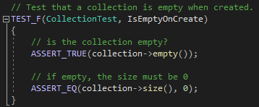
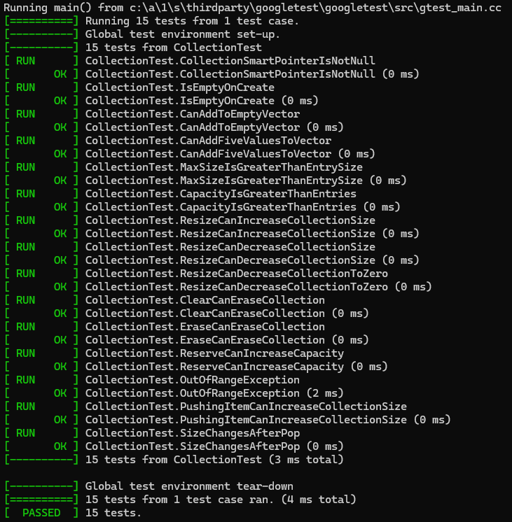
Unit Testing: Collection is empty upon creation
The unit tests shown are testing changes made to a vector collection. Each test examined a different aspect of vector manipulation to prove operations work as expected.
Test: Result:

Slide 9
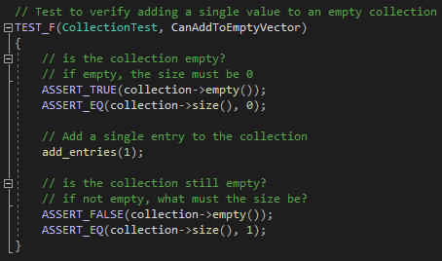
Unit Testing: Can add single value to collection
Test: Result:

Slide 10
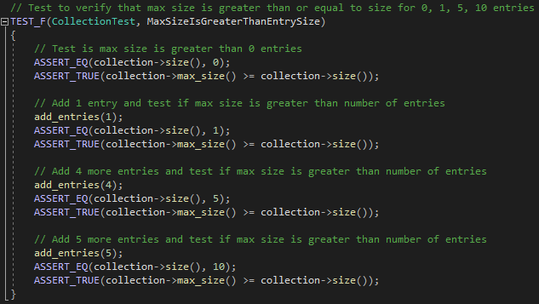
Unit Testing: Max size is greater than or equal to size of entries
Test: Result:

Slide 11
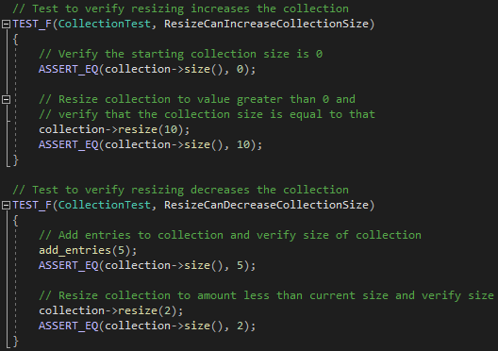
Unit Testing: Resizing can change collection size
Test: Result:

Slide 12
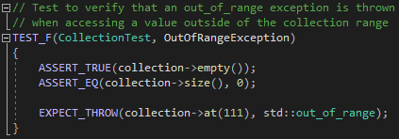
Unit Testing: Exceptions are thrown when out of range
Test: Result:

Slide 13
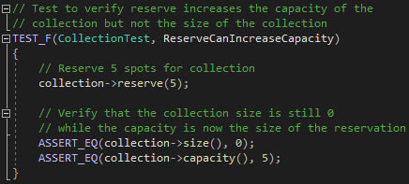
Unit Testing: Using reserve increases capacity but not size
Test: Result:

Slide 14

AUTOMATION SUMMARY

Slide 15
TOOLS
DevSecOps is the process of adding security procedures to our DevOps pipeline
Pre-production tools:
Sonarlint for developer IDEs
Sonarcloud for automated code checks
Selenium for automated testing
Production tools:
Automated logging
Automated response to malicious connections

Slide 16
RISKS AND BENEFITS
Waiting
Higher the chances that someone could take advantage of an existing vulnerability
More code being implemented that has not been compared to these standards
Acting now
Will result in correcting these vulnerabilities, from highest risk to lowest
Will take time, therefore slowing down our development cycle for a while until caught up
Starts with full evaluation of the application in development to determine what needs corrections

Slide 17
RECOMMENDATIONS
Implement the 10 coding principles going forward as there will be no remedial action required
Implement the 10 coding standards from highest priority to lowest to remediate violations that currently exist
Determine complexities associated with introducing automation to the DevOps pipeline
Review this policy yearly to update standards and outdated information

Slide 18
CONCLUSIONS
All standards should be implemented over time
The most important standards to implement now are SQL injections and memory protections
SQL injection protections will stop unauthorized access to the systems databases
Memory protections will prevent buffer overflows from occurring which could give someone access to hidden data or the ability to execute their own code
Automation can speed up development and the process to begin implementation should be started

Slide 19
REFERENCES
Encryption of data in use: A new standard in data protection. Cynance. (2022, August 16). https://www.cynance.co/encryption-of-data-in-use-data-protection/
Sei cert C++ coding standard. SEI CERT C++ Coding Standard. (n.d.). https://wiki.sei.cmu.edu/confluence/pages/viewpage.action?pageId=88046682
Sonarsourcestatic code ANALYSIS SINCE 2008. SonarSource Rules. (n.d.). https://rules.sonarsource.com/
What is AAA Security?. Fortinet. (n.d.). https://www.fortinet.com/resources/cyberglossary/aaa-security

